Slide 1
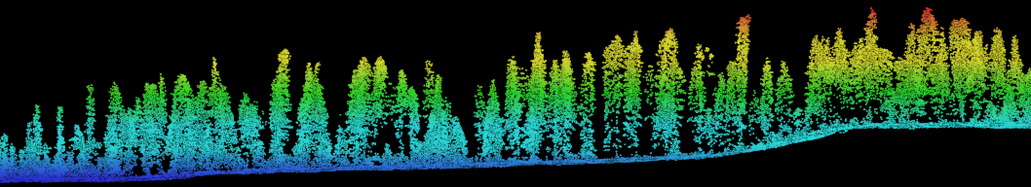


Update from the Aleza Lake Research Forest presented by: Colin Chisholm RPF, MSc. Candidate for: PEM Methods Development – Fall 2017 Workshop Oct. 5, 2017
Notes:
Greetings
Colin
My two hats

Slide 2
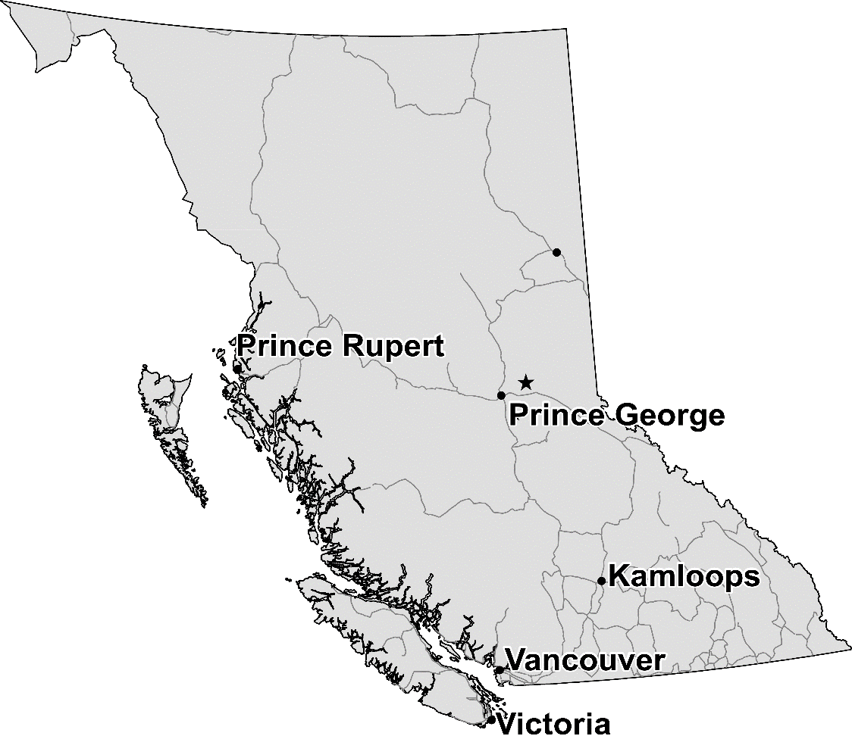
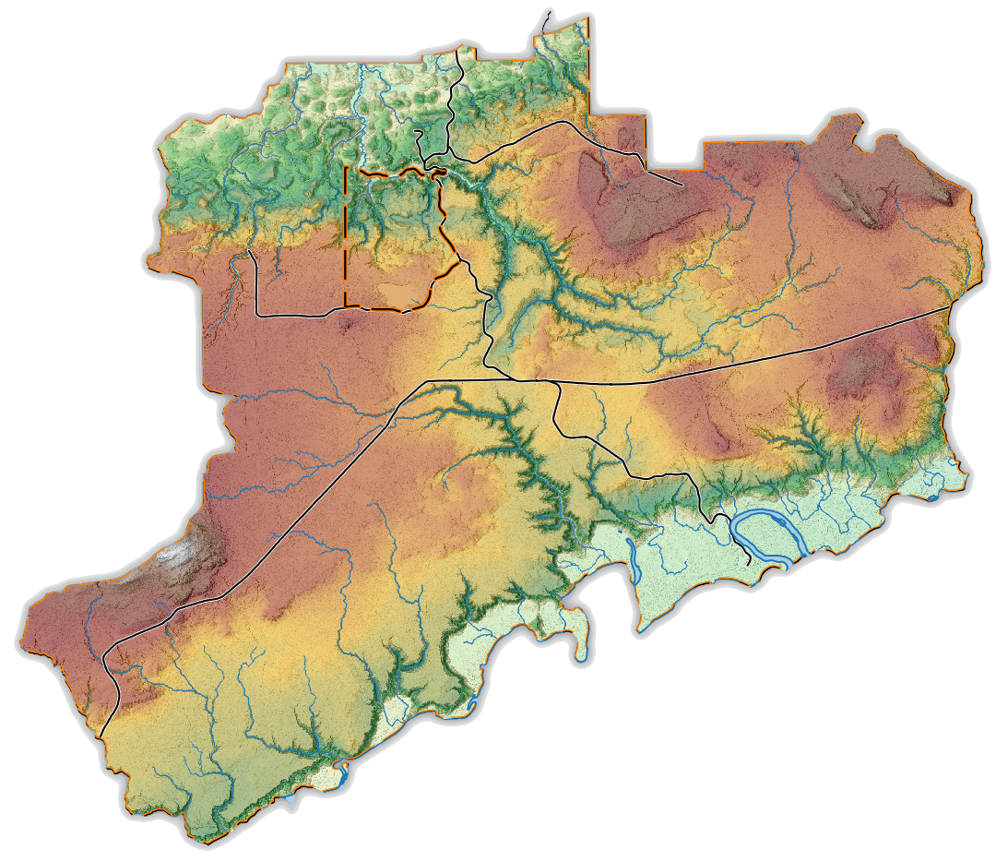
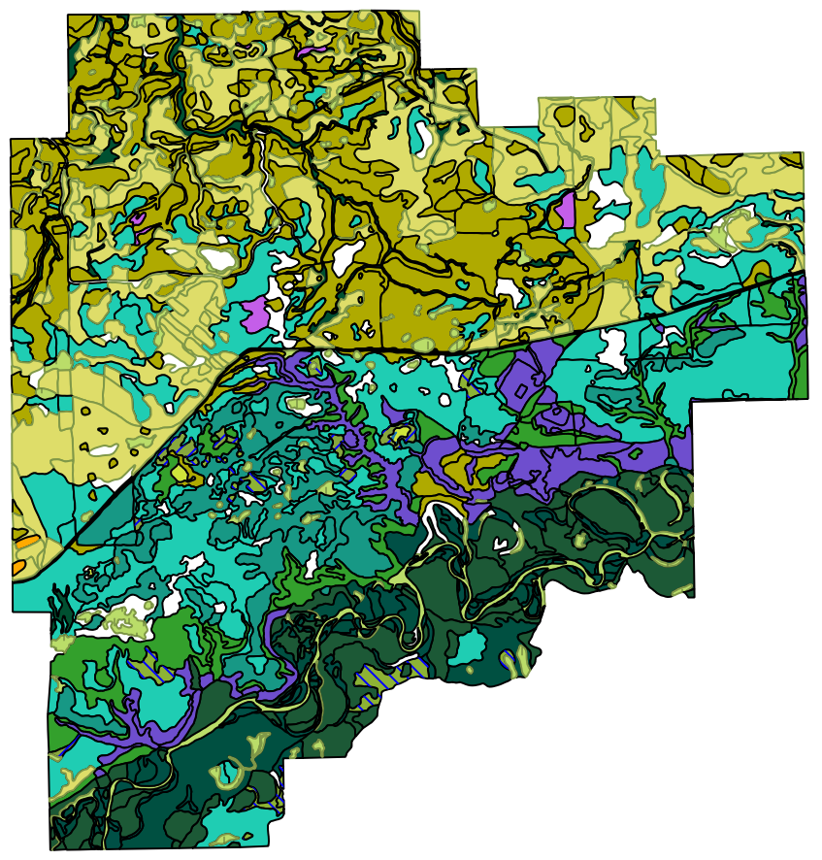
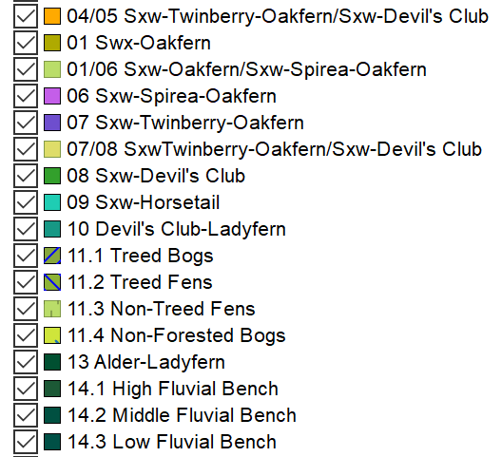
Aleza Lake Research Forest
Legacy
G&Y Plots (P. Barr 1924)
Progeny and Provence Trials
Terrestrial Ecosystem Mapping (’95)
Demonstration and Education
Alternative Silv. Systems
Planting trials
Pilot Site for PEM Development
1995 TEM
Notes:
Location, size , tenure

Slide 3
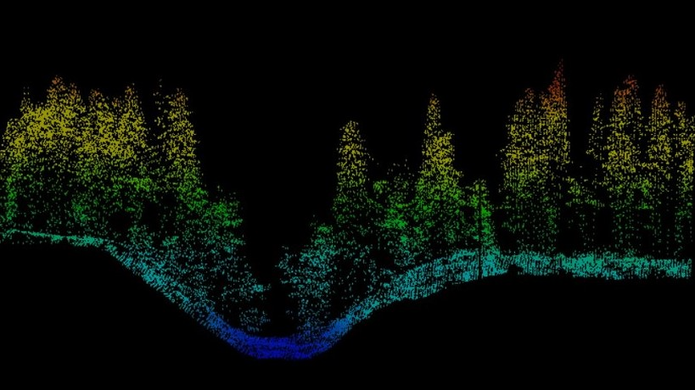
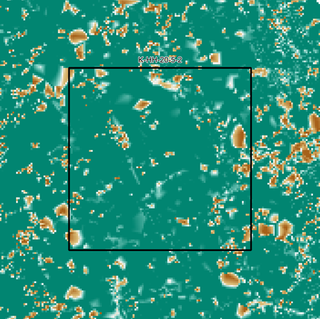
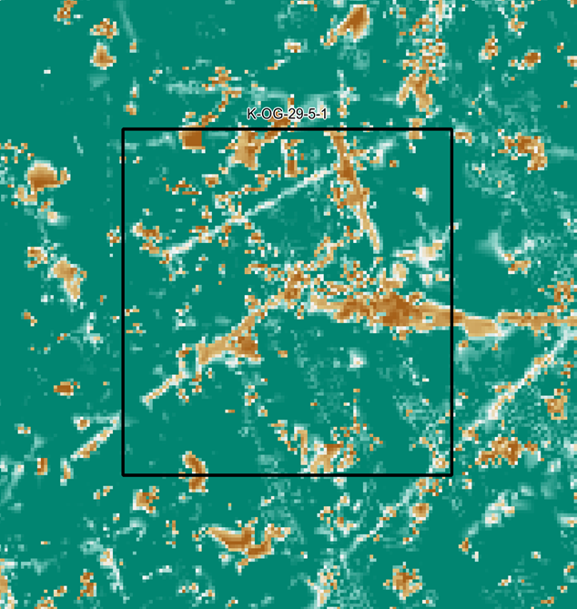
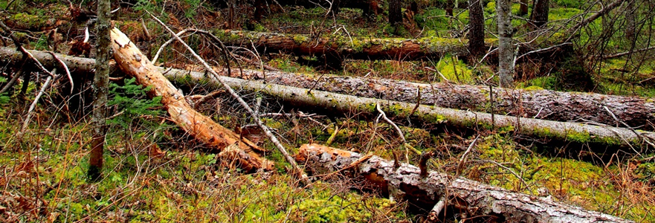
Colin’s Research
Biodiversity
Gov. orders / objectives
Forest Stand Structures
Vegetation
Coarse Woody Debris
Remote Sensing
Dr. Che Elkin Supervising
Coarse woody debris with and without Harvest History
Notes:
Government Orders related to old forest objectives
Explain the Models presented
PEM is not my primary question but definitely speaks to biodiversity
LiDAR to examine forest stand structures including CWD
Warning Next slide is psychedelic

Slide 4
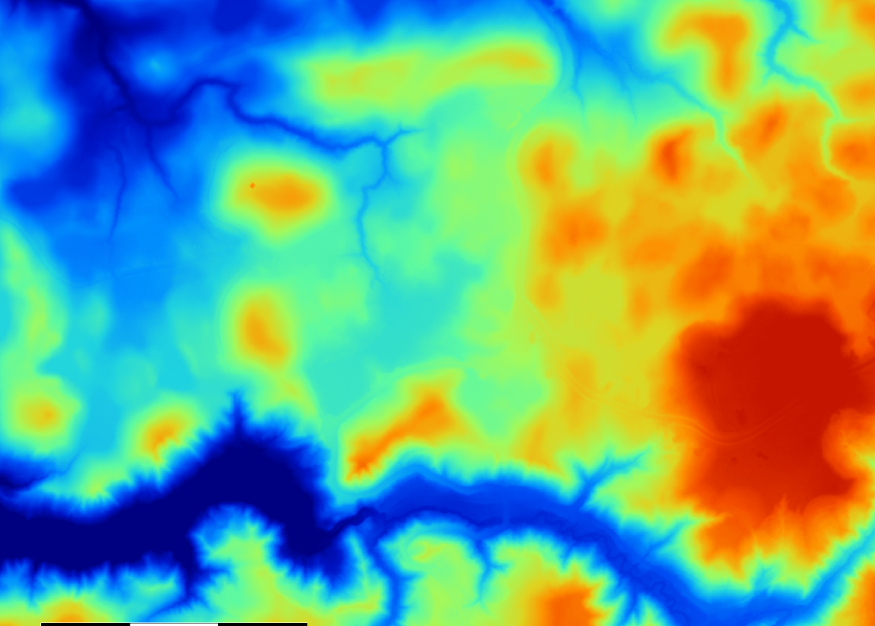
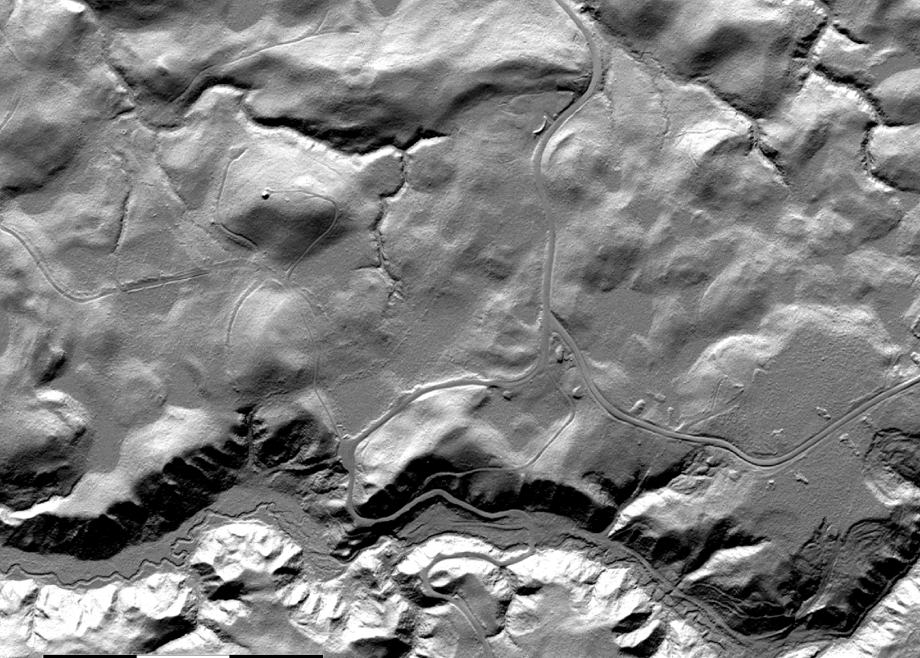
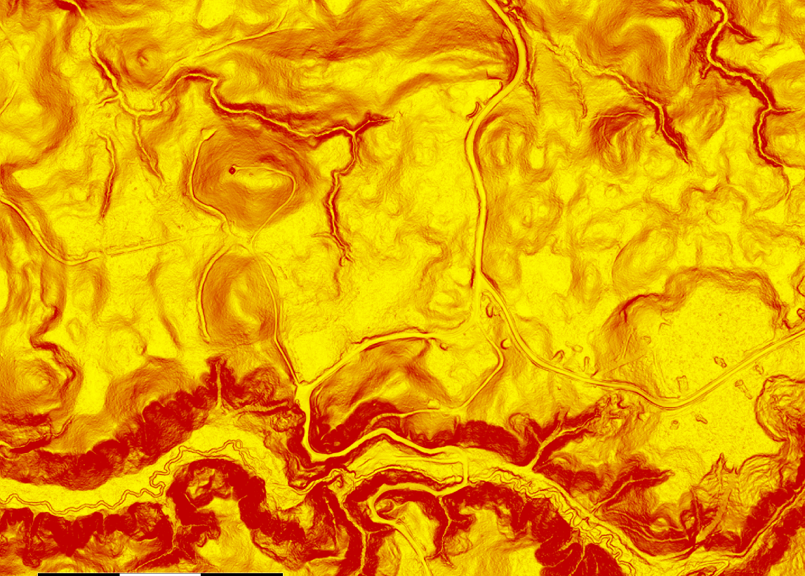
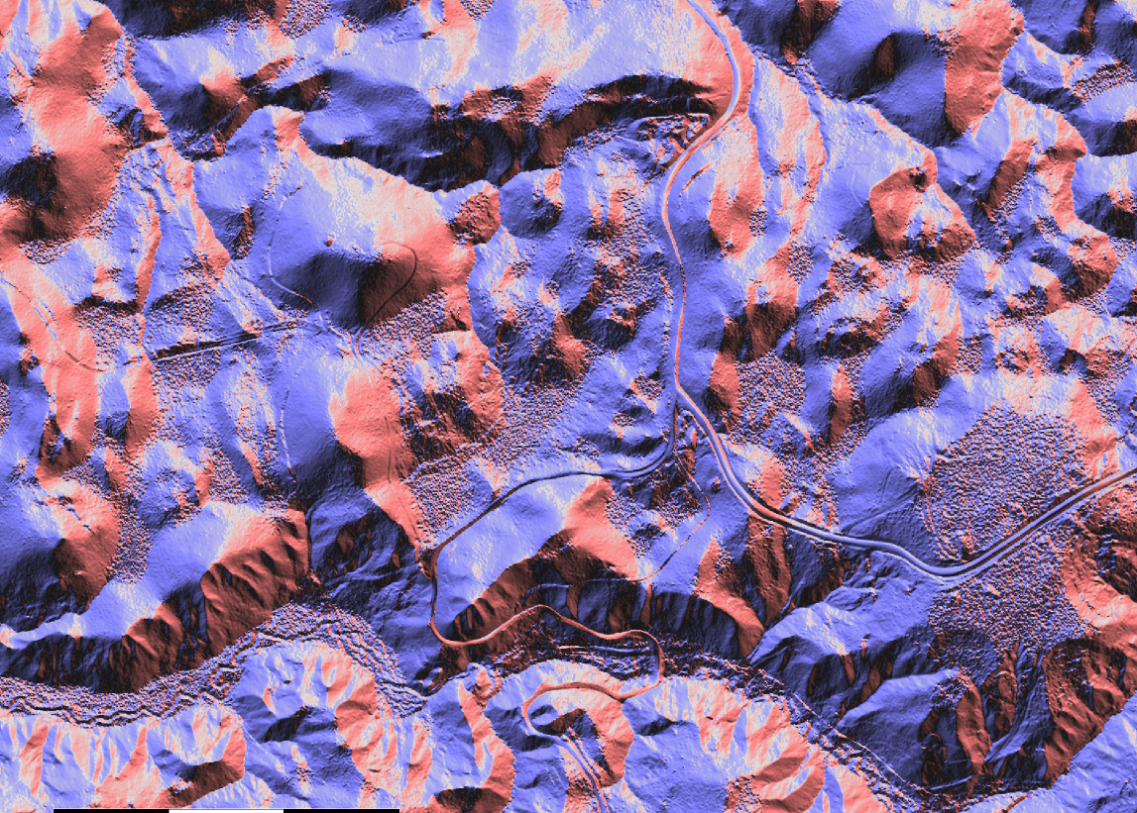
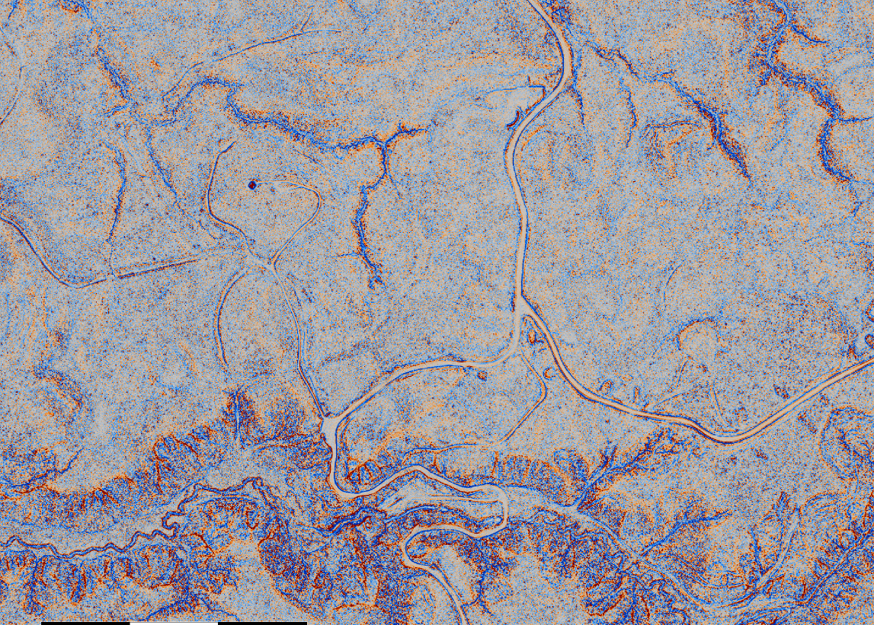
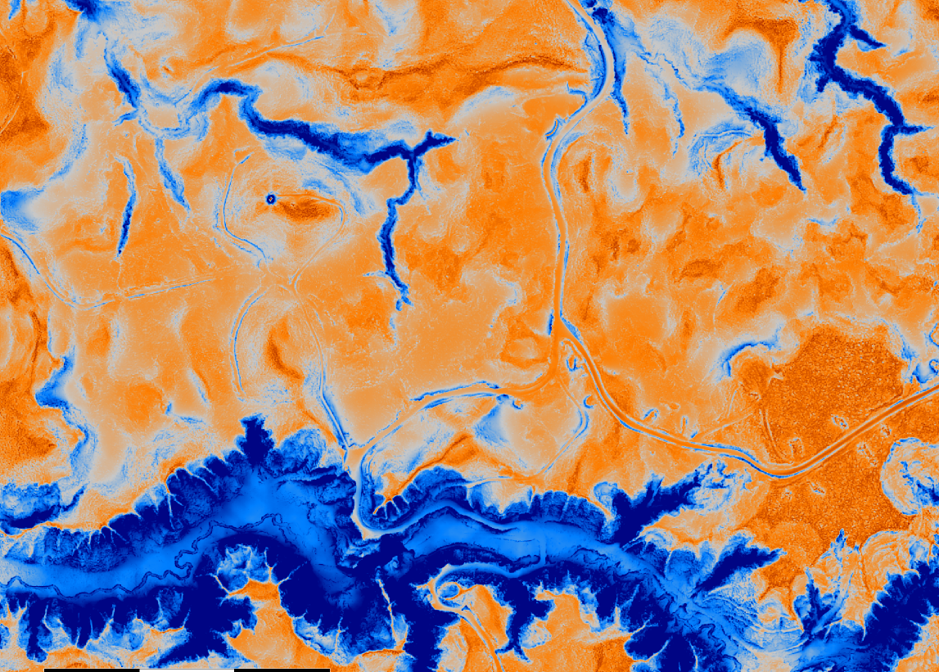
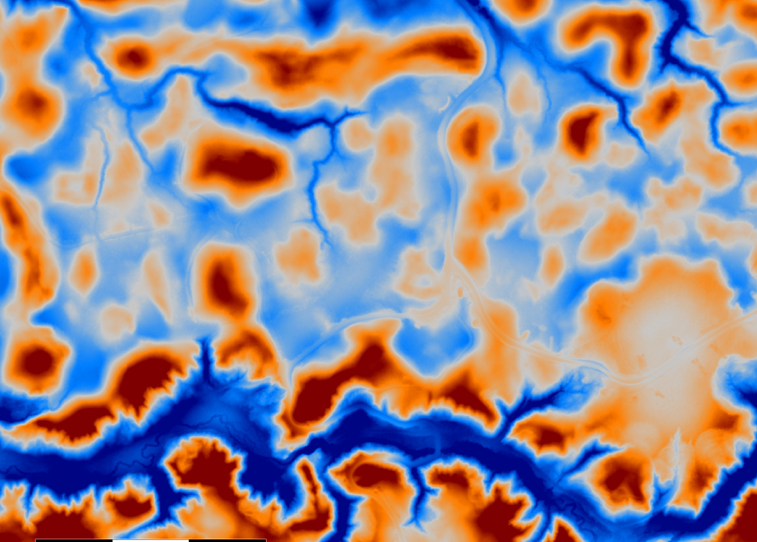
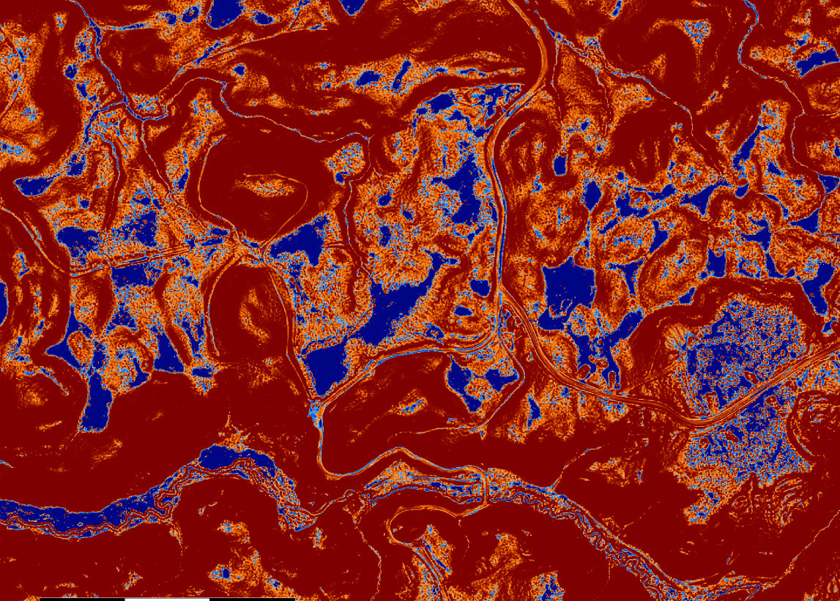
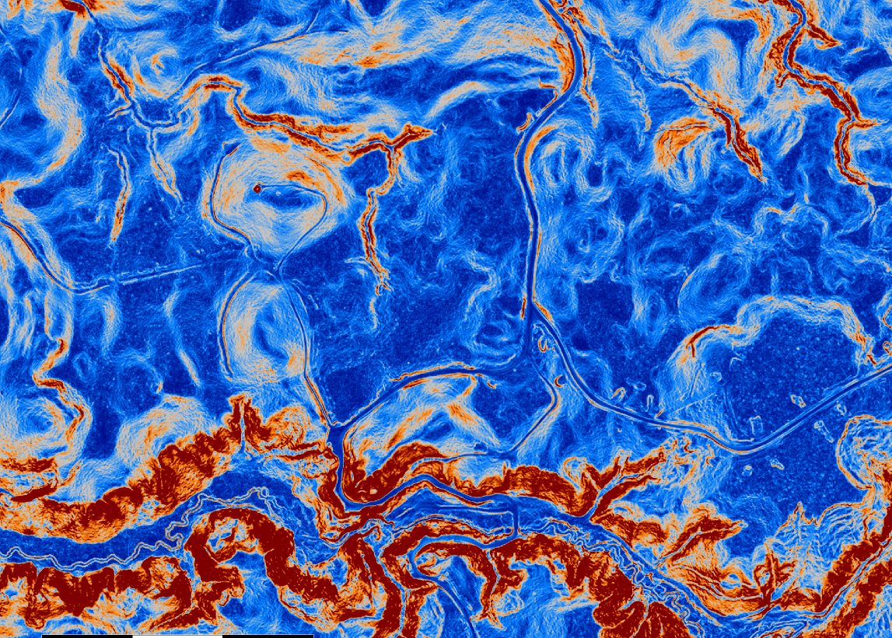
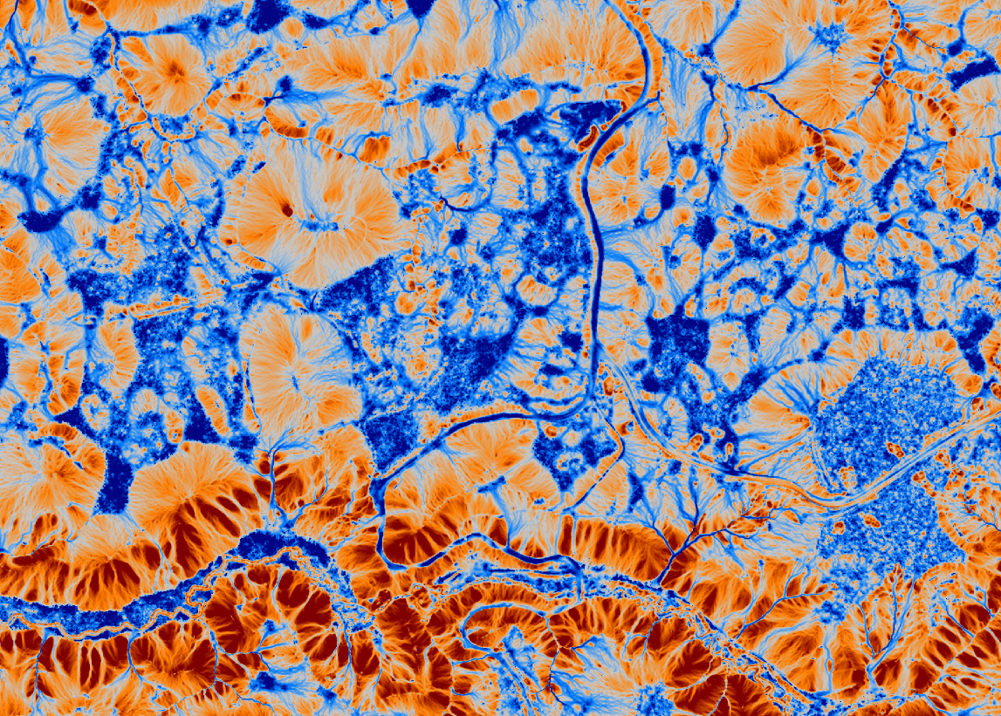
Update
Data Layers
Notes:
Top: Digital Elevation Model, Hillshade model
Middle: Slope, Aspect, General Curvature, Positive Openness
Bottom: Topographic Position Index, Multiresolution Index of Valley bottom flatness, Terrain Ruggedness Index, Topographic Wetness Index

Slide 5
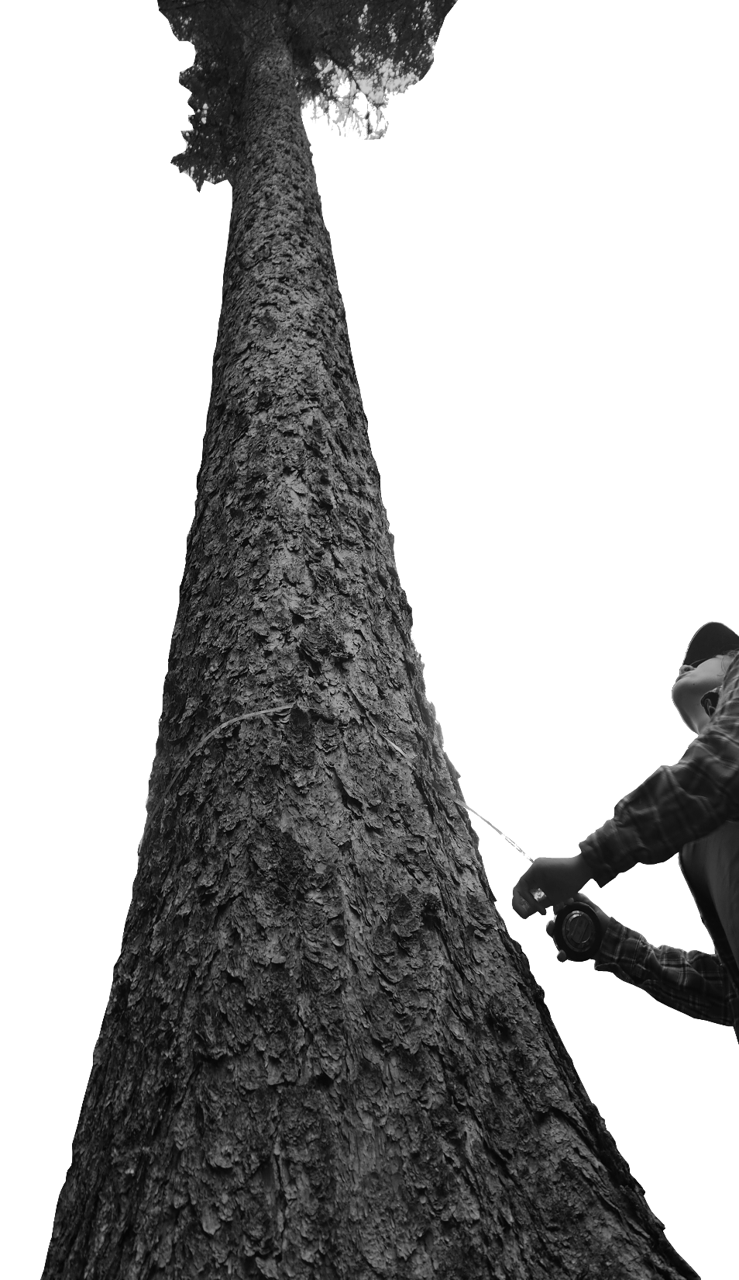
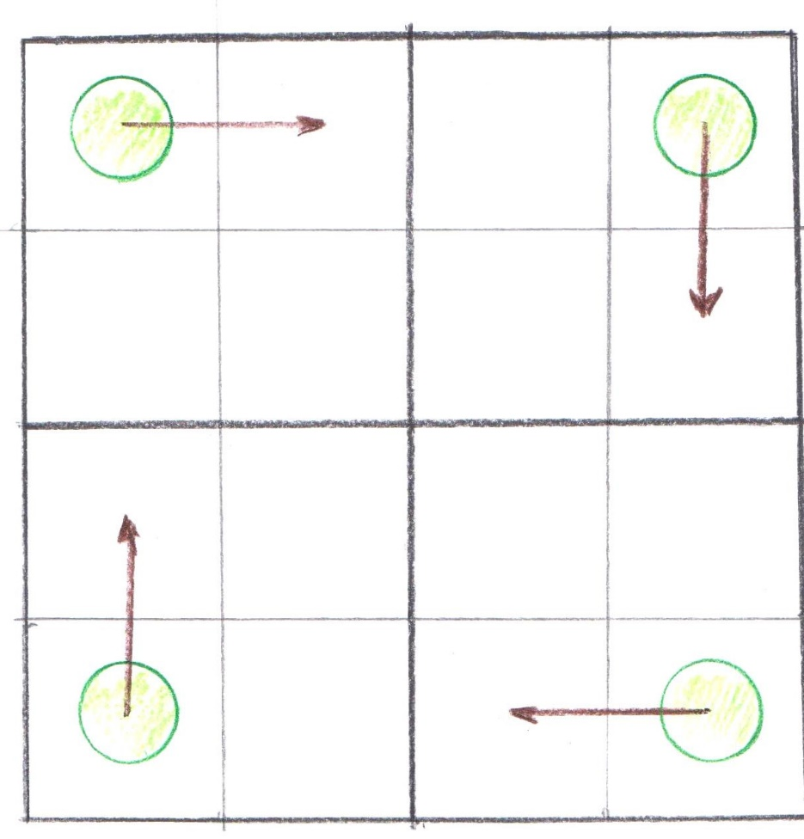
Empirical Data Collection
Plot Design
Nested Plots
Quadrants
Area based tree stand metrics
Coarse woody debris surveys
Vegetation Surveys

Slide 6
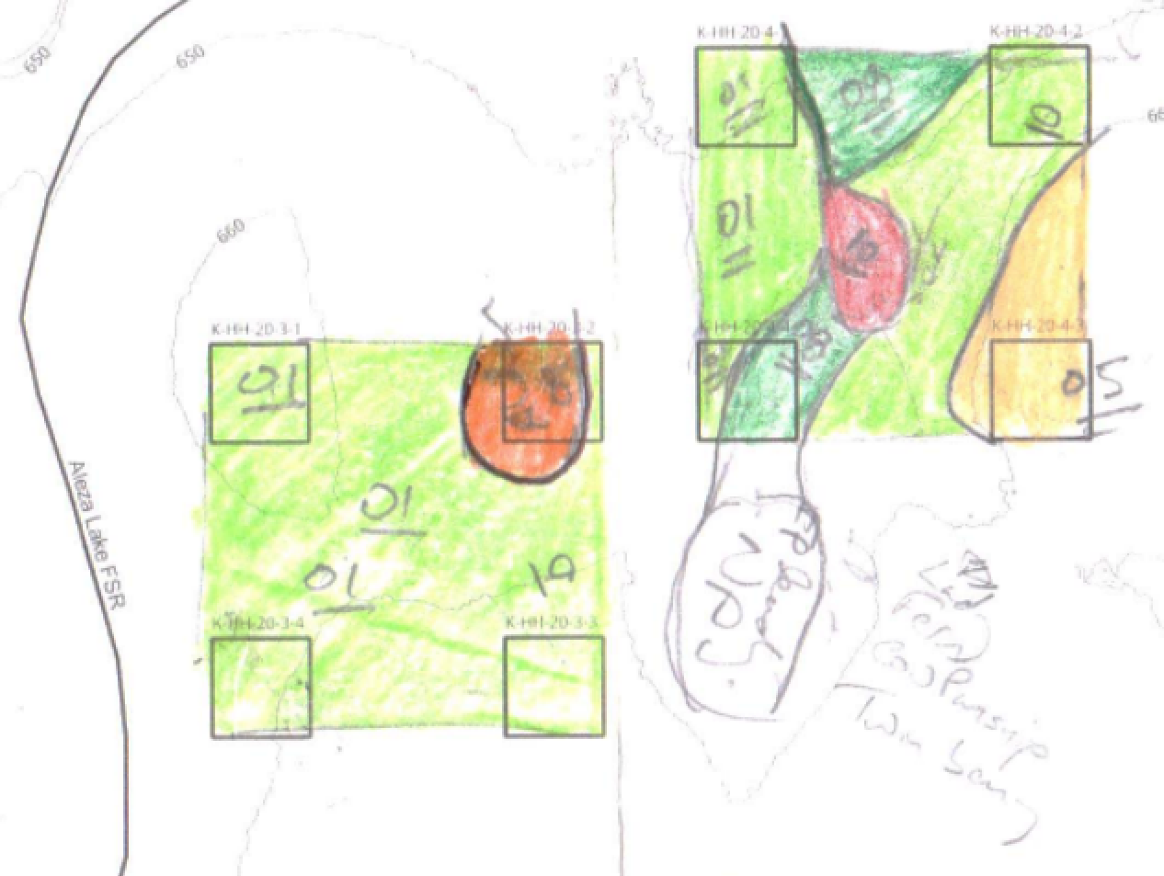
Empirical Data Collection
Site Series Data
Sketch maps
Polygons
Raster
Modeling
Notes:
PAUSE change gears to productivity questions

Slide 7
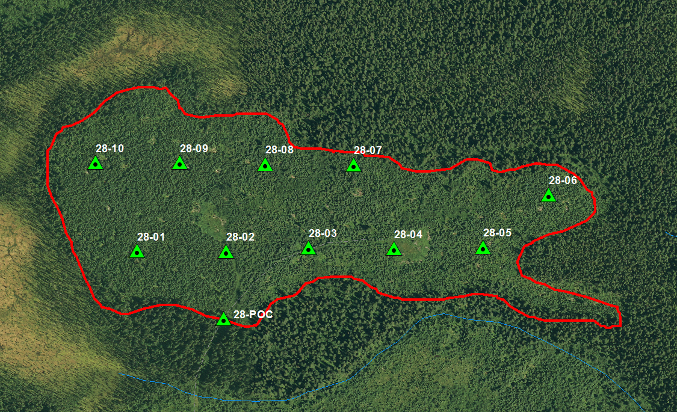
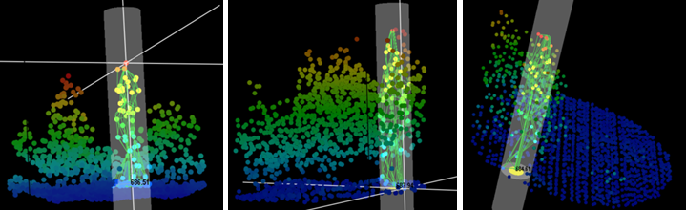
Site Productivity
Initially Examined with FUSION/ LDV
Measuring tree heights in the point-cloud
Screenshots form USDA’s Fusion/LDV

Slide 8
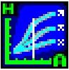
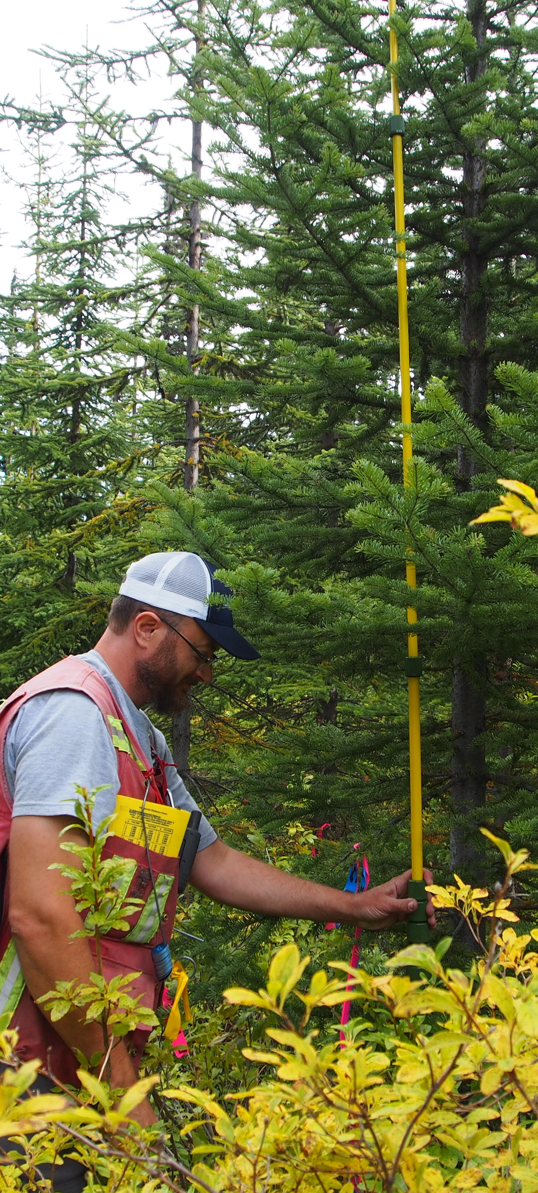
Site Productivity
ALS/LiDAR Area Based Approach 99%

Slide 9
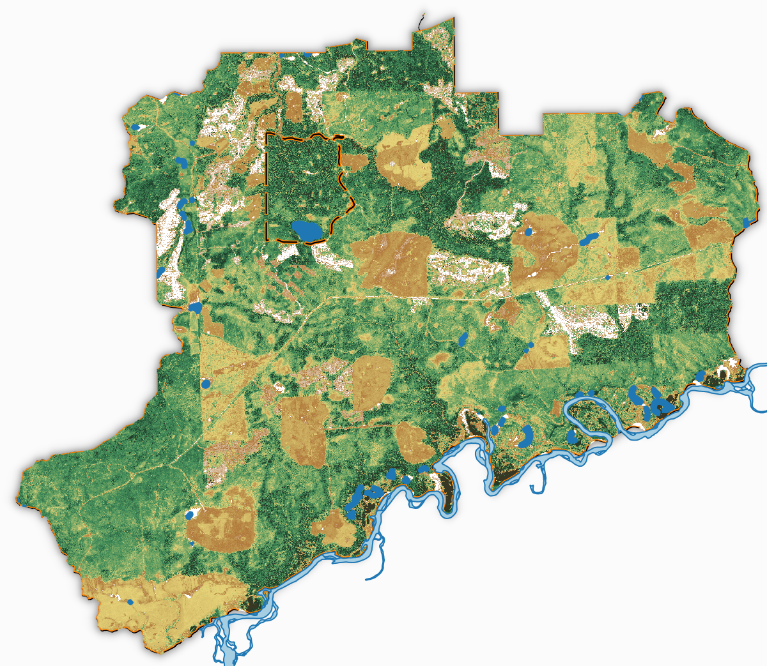
Aleza Lake Research Forest
We have the data
This PEM Project aligns ALRF objectives for
Research
Forest Management
Teaching and Demonstration
The ALRF is fully committed to the success of this project
ALRF 95% Stand Height Model

Slide 10



Towards Success
Data Layers - ALS/LiDAR
- Empirical
Model Design
Modeling
PEM Generation
Validation
Notes:
Where I would like our discussion to go
Focus in on Model design
We have data, and we have a good number of data layers … at least to start with.
The ALRF has empirical data (at least enough to get started with)
Regarding the model design my immediate questions revolve around
Gain clarity on the current modeling structure that we have in place (random forest)?
Who will lead the charge on this?
Other process based models to be considered?

Slide 11
Update from the Aleza Lake Research Forest presented by: Colin Chisholm RPF, MSc. Candidate for: PEM Methods Development – Fall 2017 Workshop Oct. 5, 2017
Notes:
Change the Graphics

